Slide 1
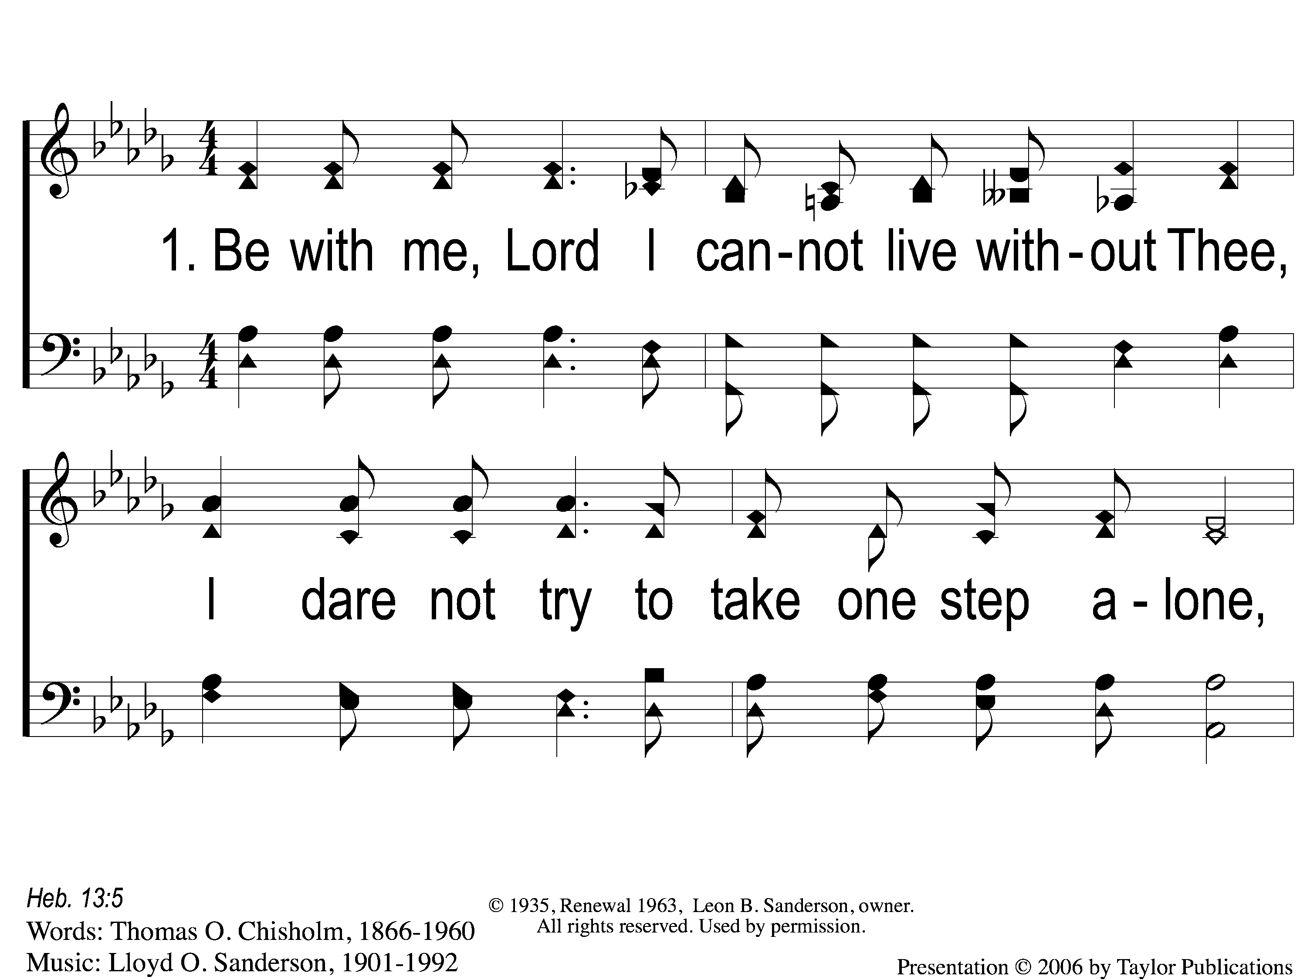
1-1 Be With Me Lord
Be With Me Lord
32

Slide 2
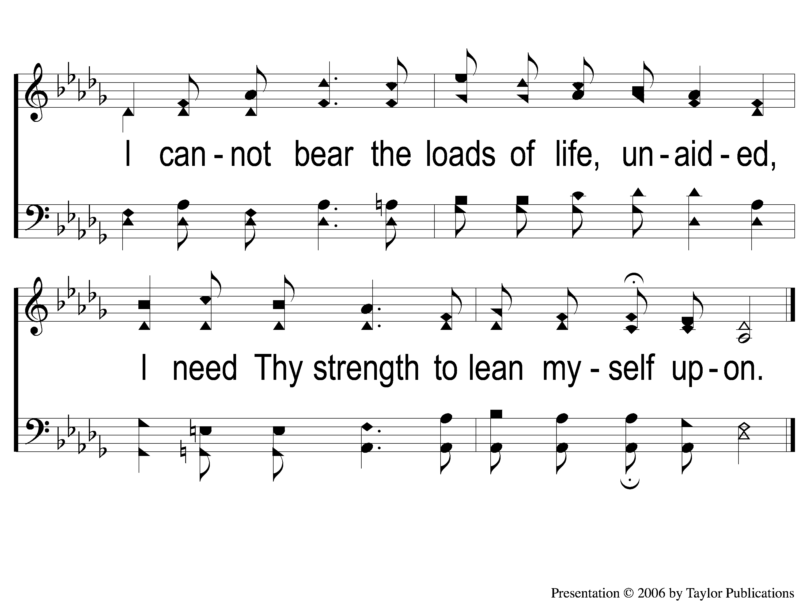
1-2 Be With Me Lord
Be With Me Lord
32

Slide 3
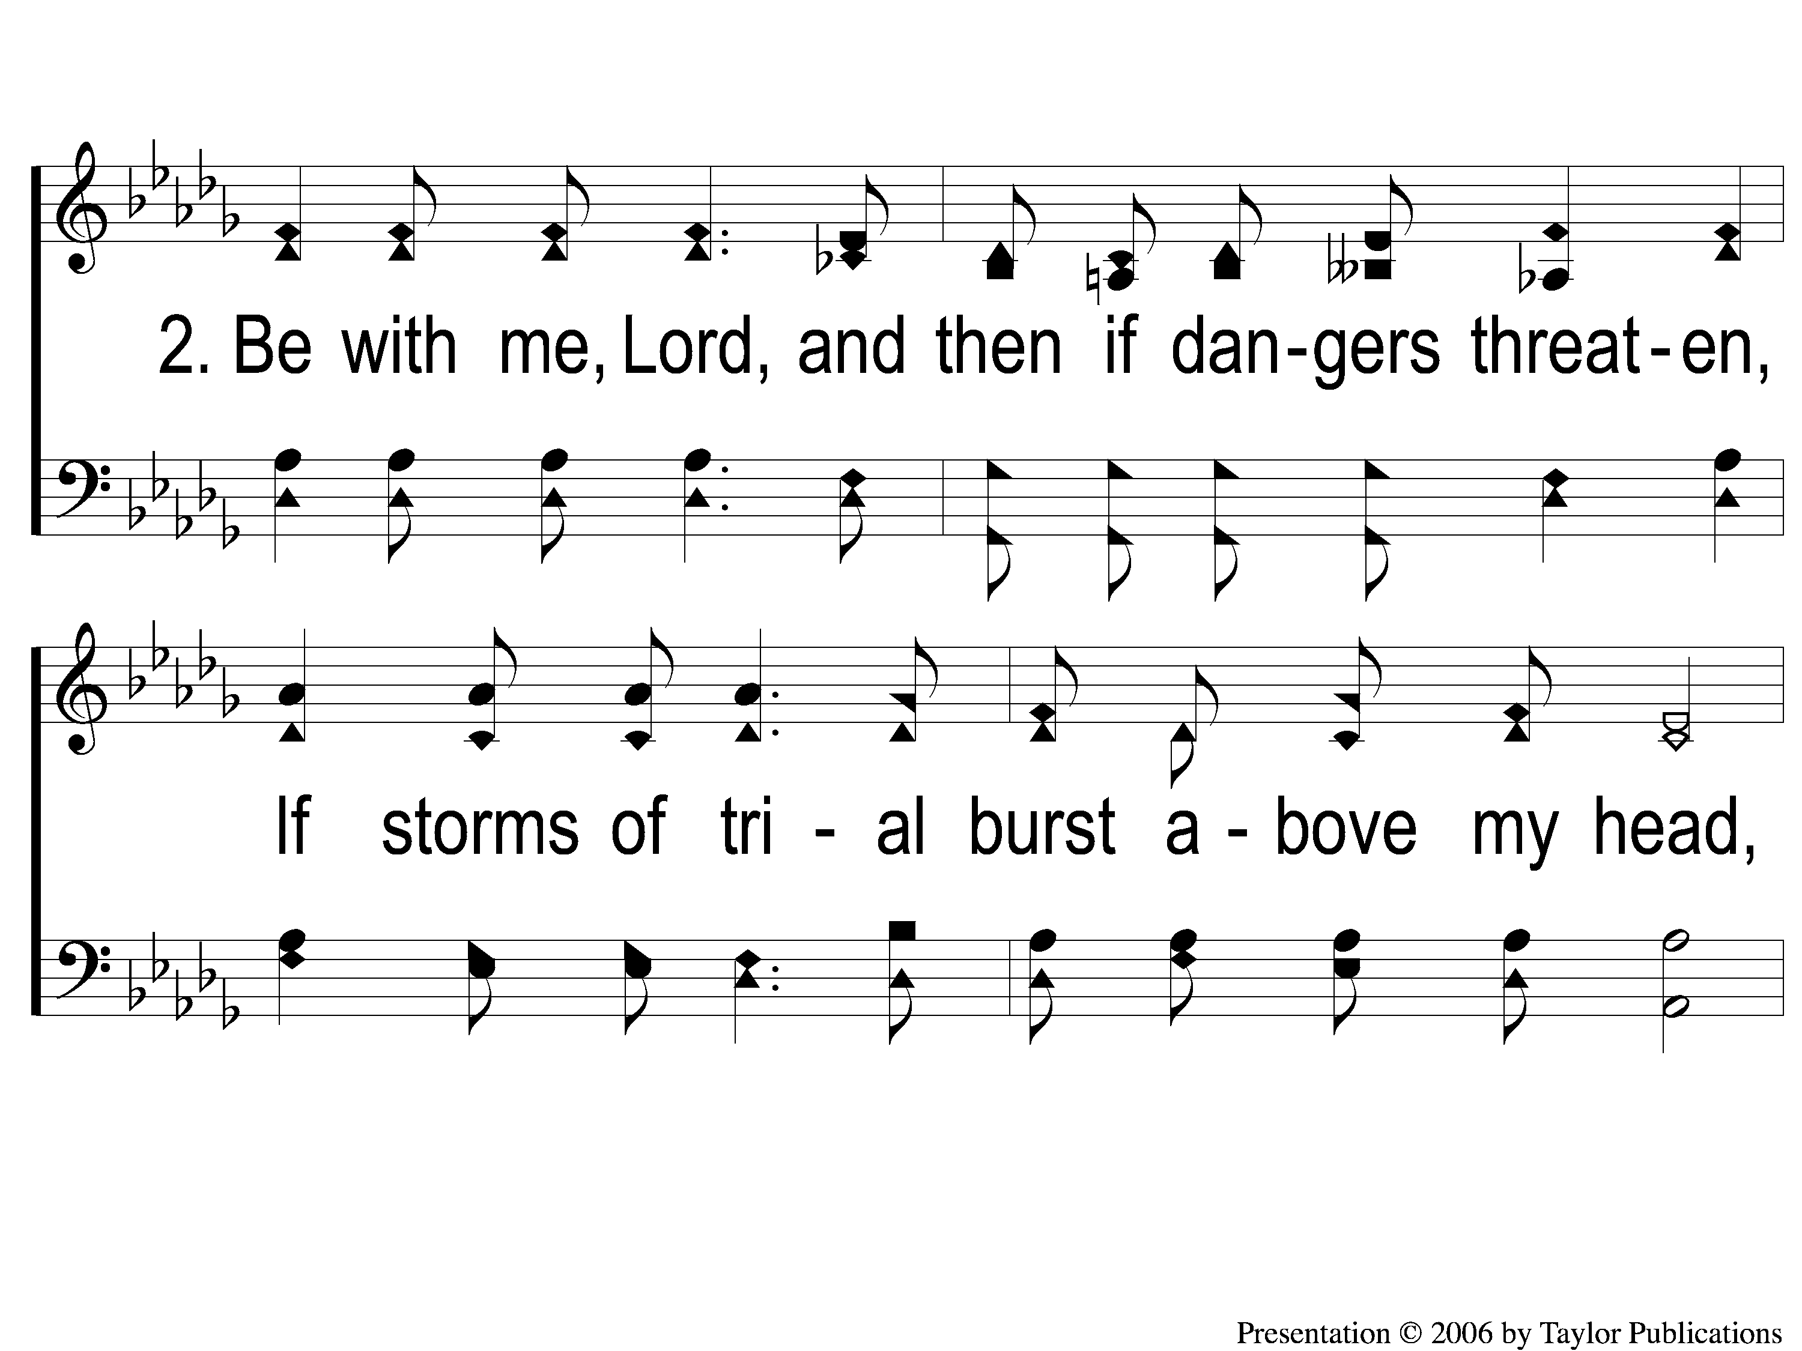
2-1 Be With Me Lord
Be With Me Lord
32

Slide 4
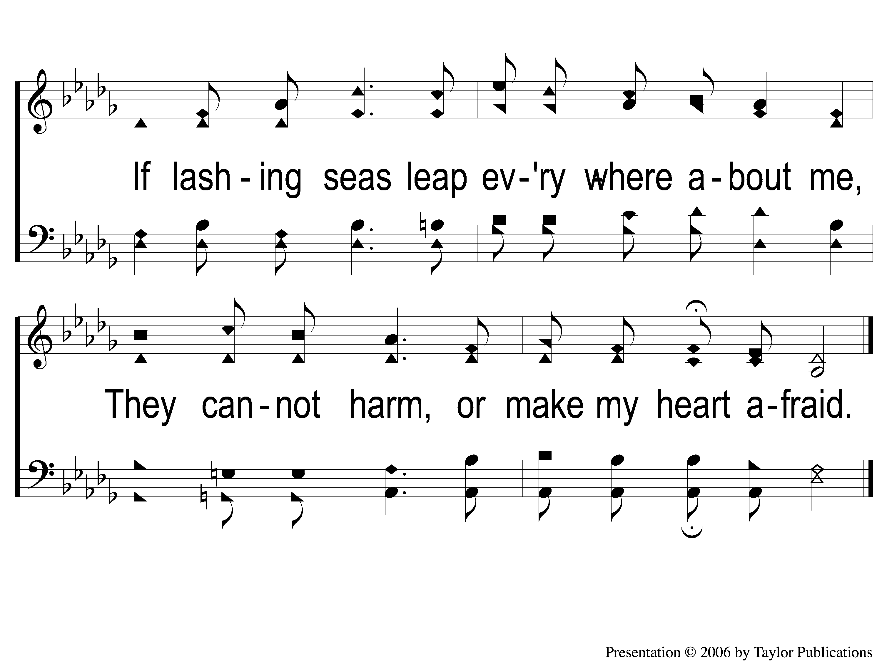
2-2 Be With Me Lord
Be With Me Lord
32

Slide 5
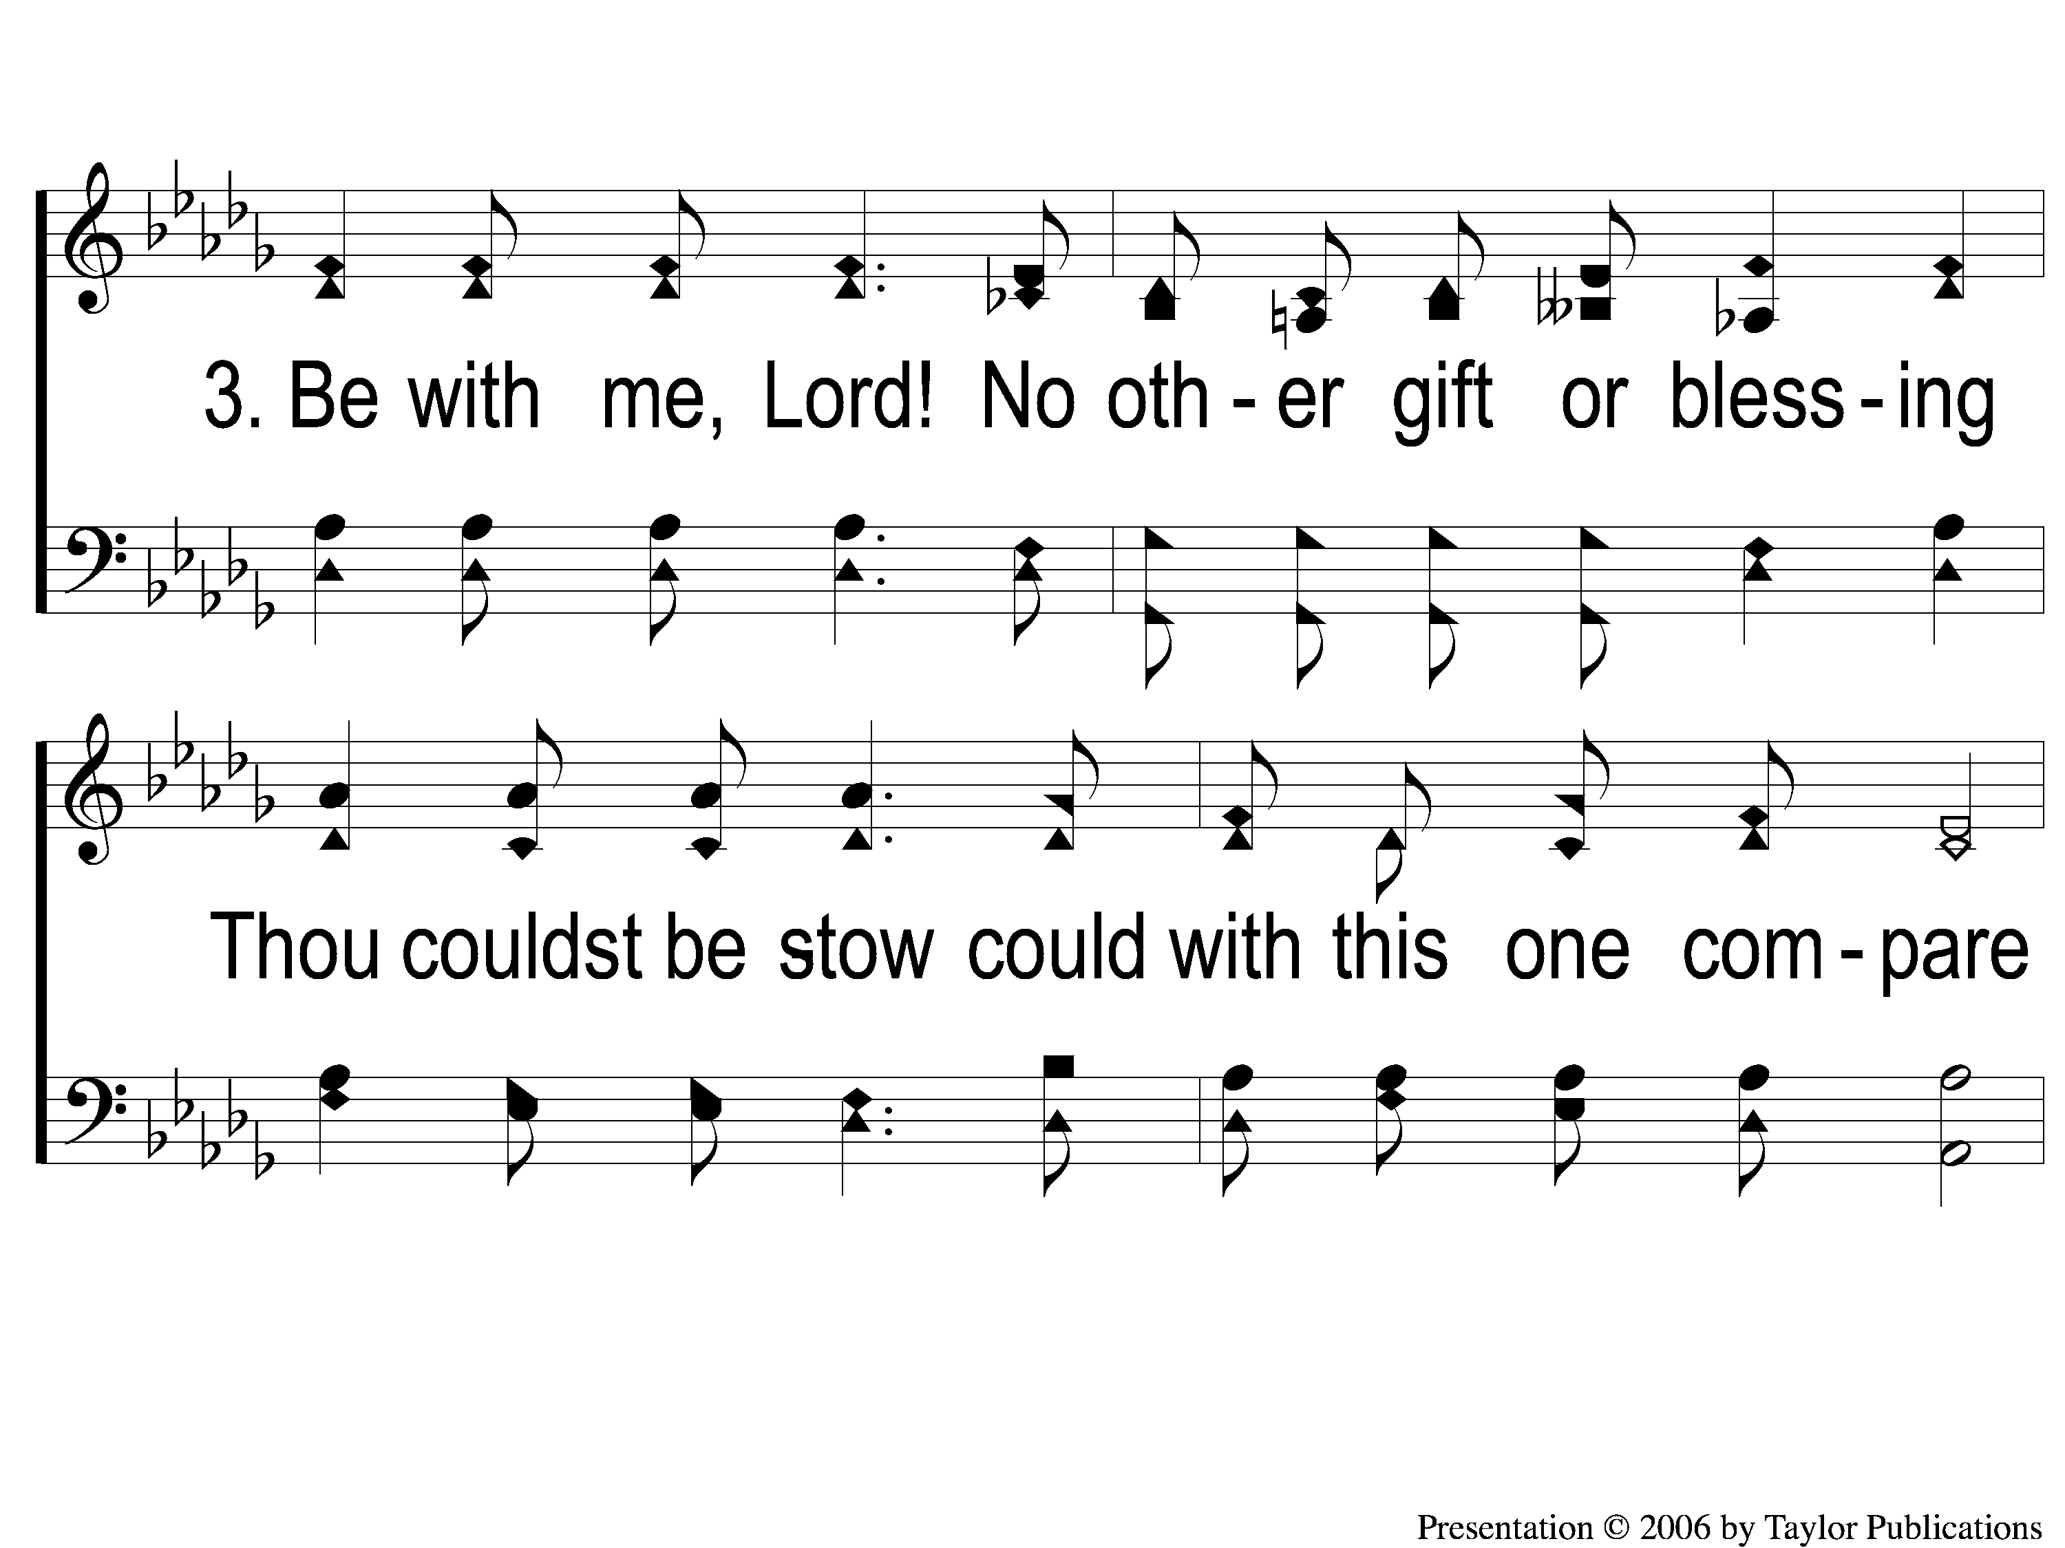
3-1 Be With Me Lord
Be With Me Lord
32

Slide 6
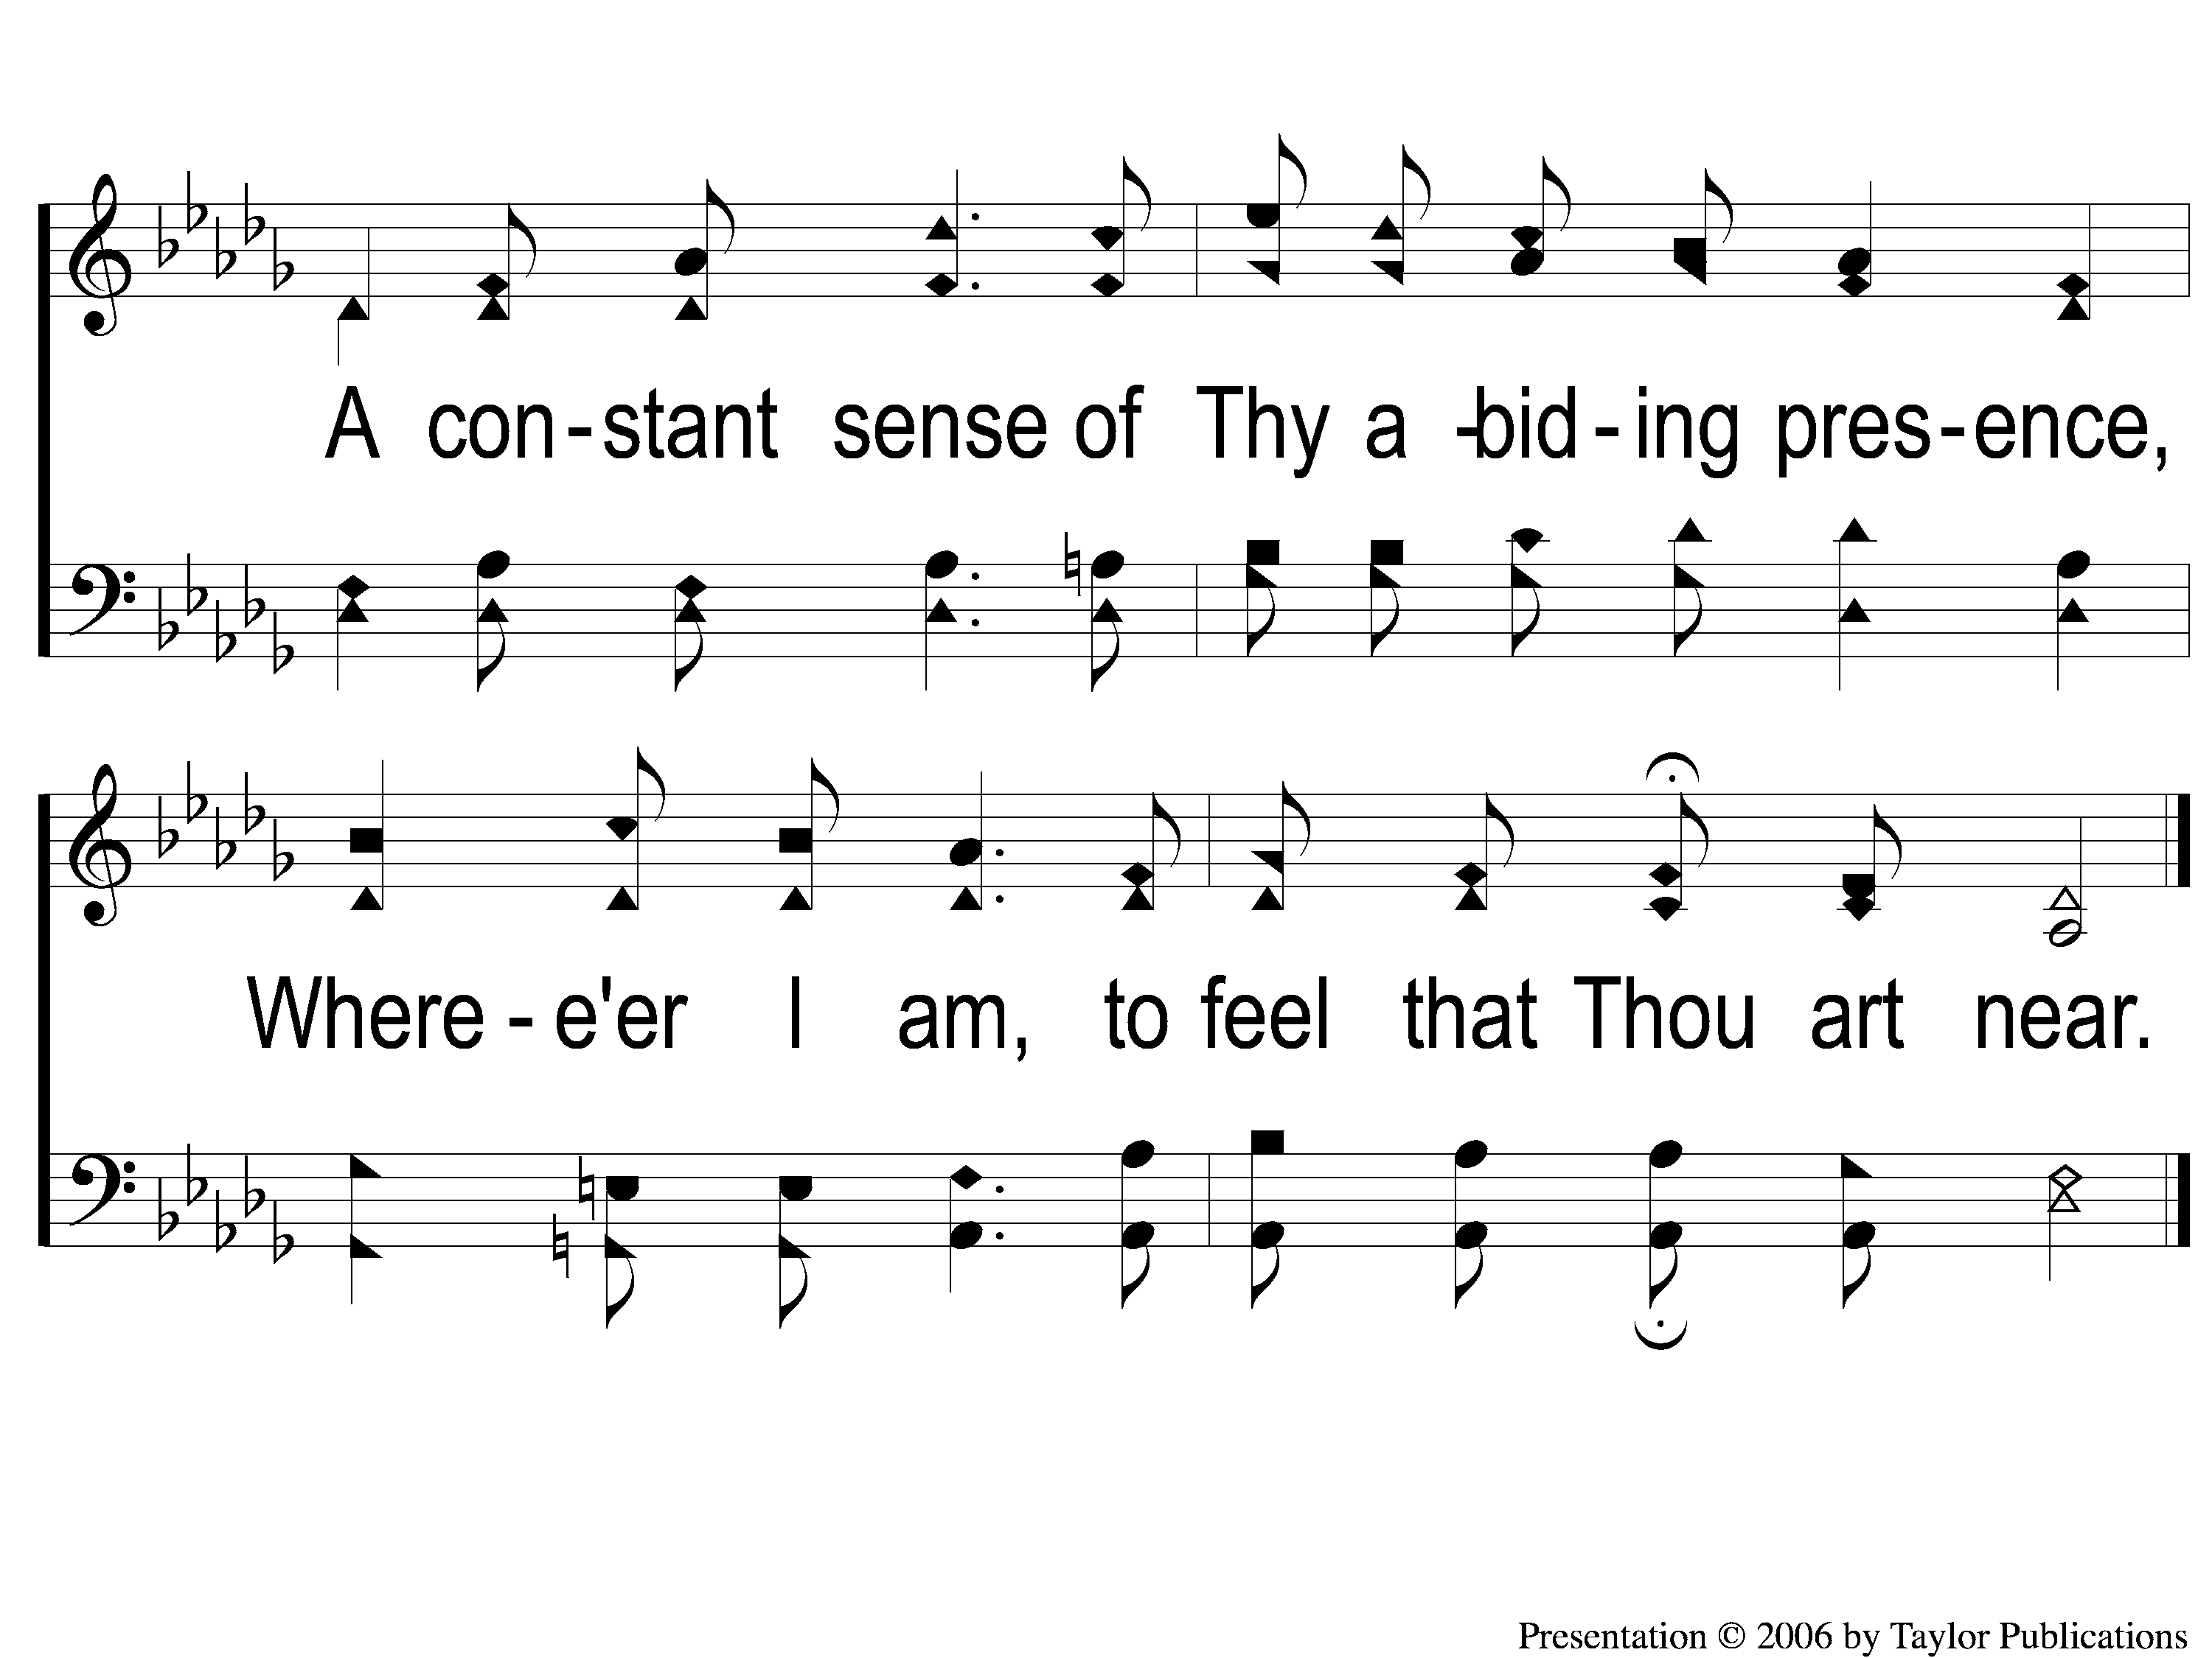
3-2 Be With Me Lord
Be With Me Lord
32

Slide 7
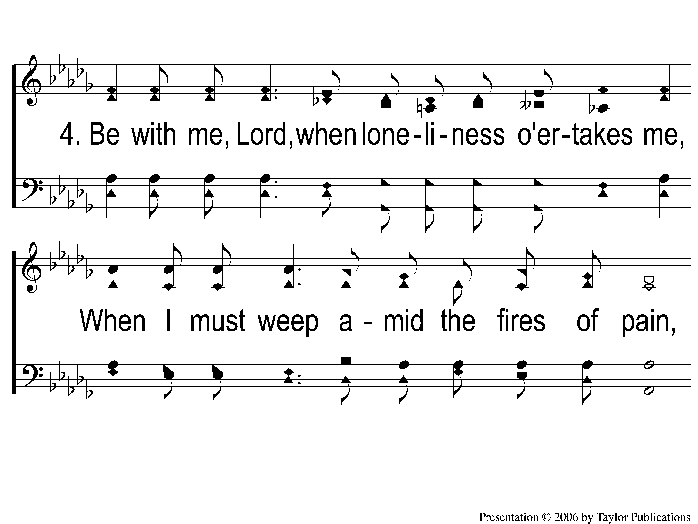
4-1 Be With Me Lord
Be With Me Lord
32

Slide 8
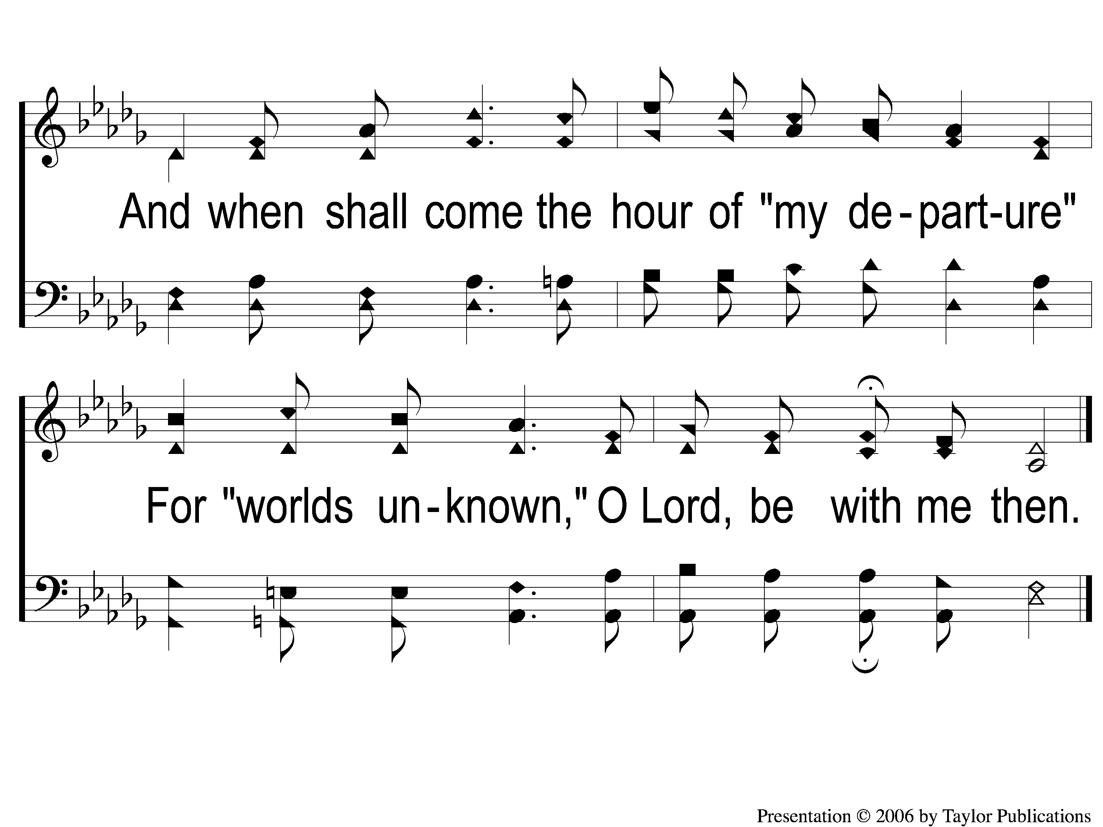
4-2 Be With Me Lord
Be With Me Lord
32

